Slide 1
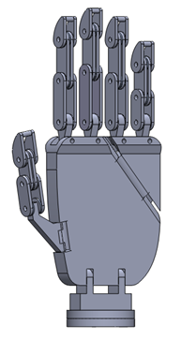
Semi-transparent grid map (bird’s eye view)
Command box
Timer
00:38
STOP!
Robot hand
First person view
Cars

